Slide 1
Advanced Computational Methods in Geotechnical Engineering
Lecture
June 13, 2008

Slide 2
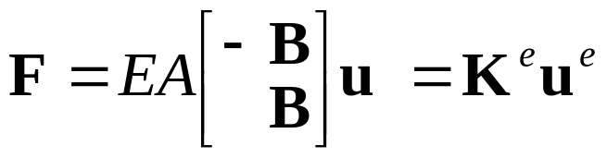
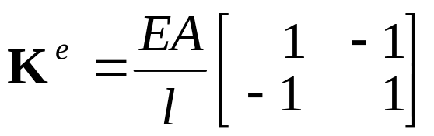
- In our last class we discussed:
Formulation of FE equation for 1D problem:
- Direct Approach Method
- Assuming equilibrium at ends of the bar.

Slide 3
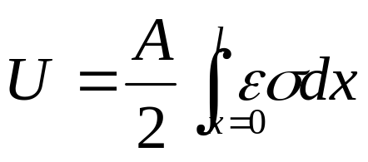
Variational Approach
- Here, the equilibrium along the total length of the bar is assumed (instead of ensuring equilibrium at the ends of the bar only).
- The equilibrium condition is stated by writing down the total energy in the bar and minimize it with respect to the nodal displacements.
- The strain energy (or internal work) in the bar is given by:

Slide 4
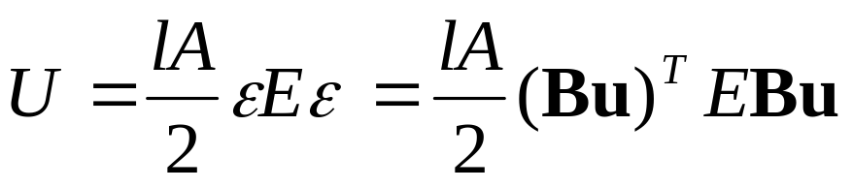
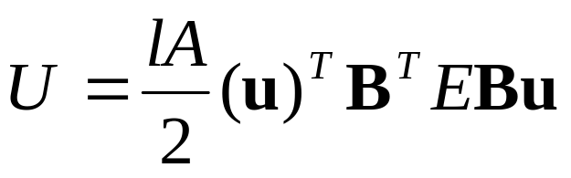
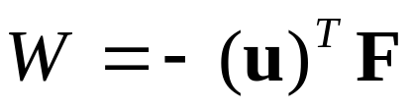
- Which is simply:
- Using the relationship between transpose matrices:
- The potential energy of the external force is given by:

Slide 5
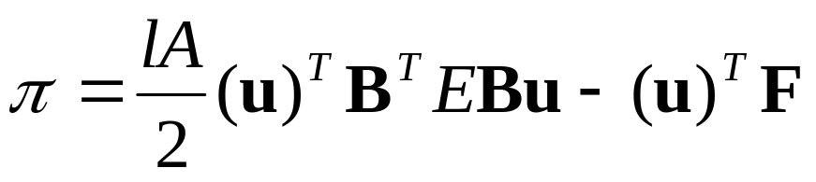

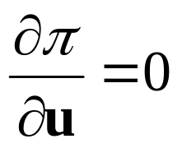
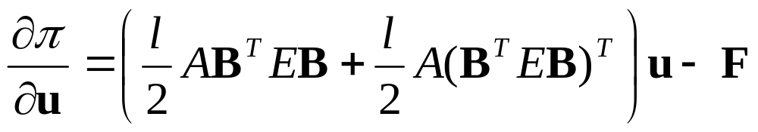
- And the total potential energy is:
(A)
- The condition that must be a minimum can be written using variational calculus as:
- Differentiating eqn. (A) we have:

Slide 6
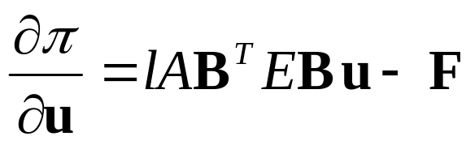

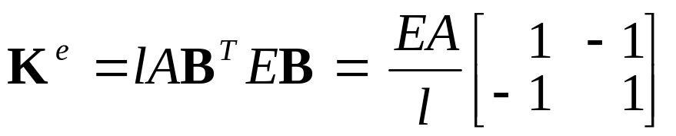
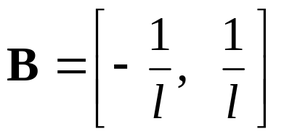
- Or since E is a scalar:
- And setting this to zero gives:
- where:
- Note:

Slide 7









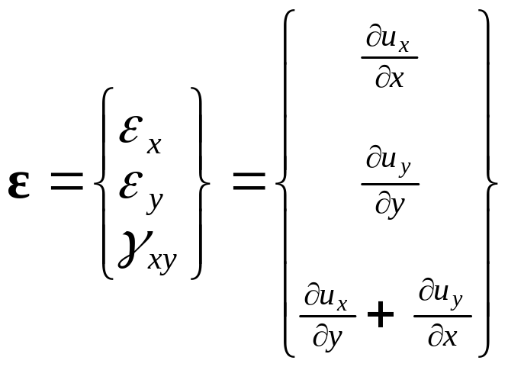
Two-Dimensional Elasticity Problem
- To drive the stiffness matrix for a plane element, the strain inside the element is expressed in terms of nodal displacements as:
(B)
- The strain vector is given by:

Slide 8
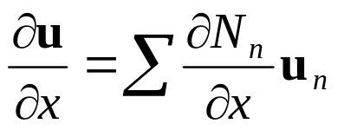
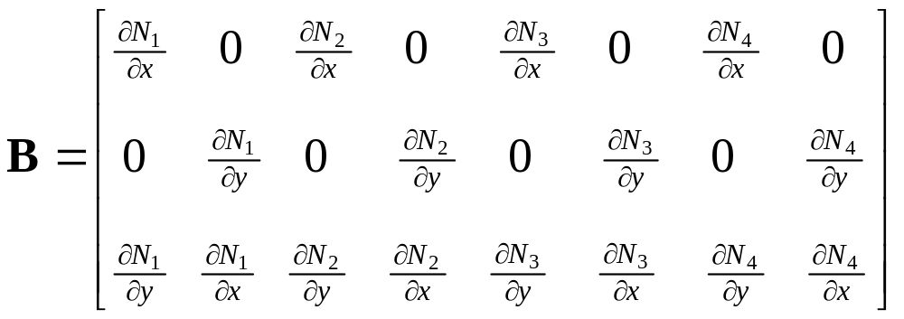
- Where:
etc
- For an element with four nodes the matrix B is thus defined as:

Slide 9
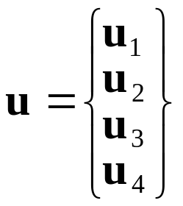
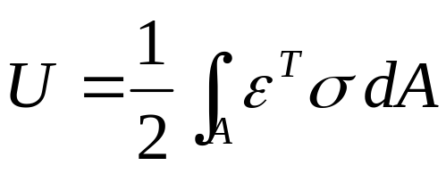
- The vector of nodal displacements is given by:
- The equilibrium condition is stated using the minimum potential energy principle as explained earlier.
- The strain energy is given by:

Slide 10
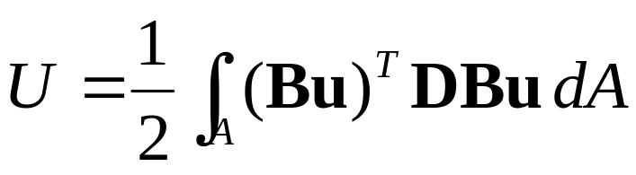
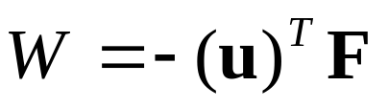

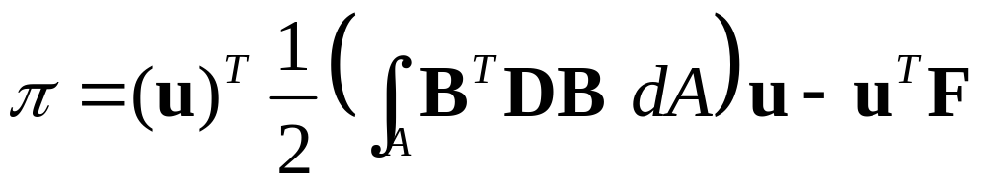
- Which after substitution of eqn.(B) is:
- The potential energy of the nodal point forces is:
- Using the relationship between transpose matrices and considering that the vector u containing nodal values of displacement can be taken out of the integral, we can write:

Slide 11
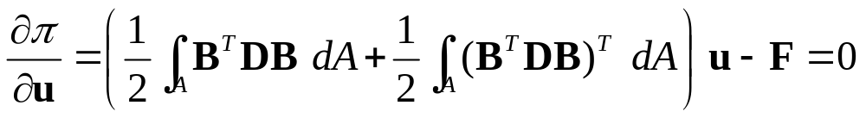
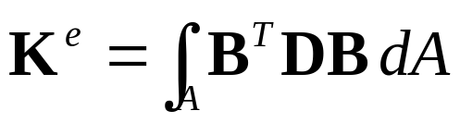
- Taking the derivative with respect to the nodal displacements we have:
- Or:
- Where provided D is symmetric, the stiffness matrix (which is also symmetric) is given by:
Example : SIGMA/W (pdf - pp. 381)

Slide 12
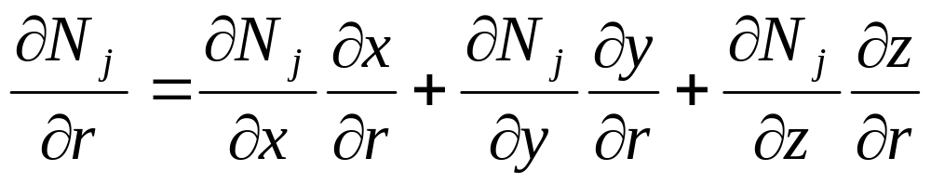
Derivatives of Shape Functions
- For the general three-dimensional case the natural derivatives in (r, s, t - directions) of the shape functions which are expressed in the natural r, s, t coordinates are, according to the chain rule:
etc

Slide 13
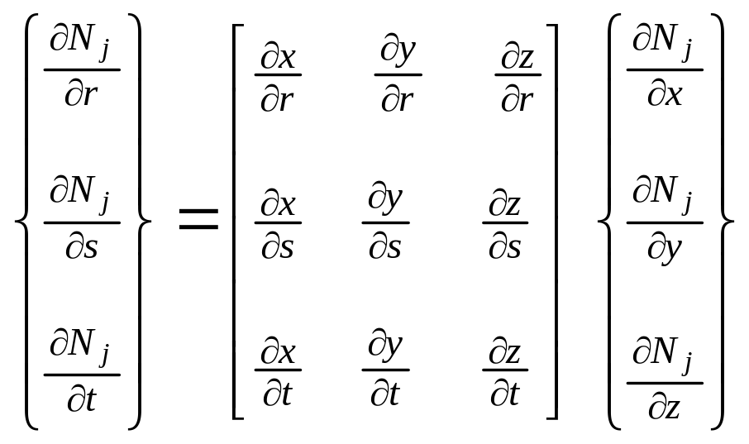
- The relationship between local & global derivatives is therefore given by:

Slide 14
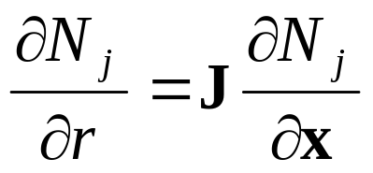
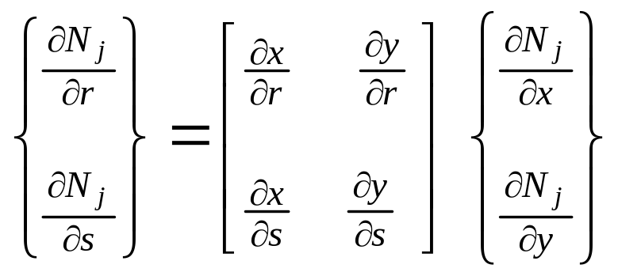
- Or:
- Where J is called the Jacobian matrix.
- For the 2D (plane element) case the Jacobian matrix is:
See SIGMA/W pp 388/9 (pdf. 400/01) & CRISP-TECHMAN pp 81

